Slide 1

Customer Shopping Behavior Analysis
Analysis of 3,900 transactions to reveal spending patterns, segments, product preferences, subscription behavior, and actionable recommendations for growth.

Slide 2

Dataset Snapshot
Key facts
Rows: 3,900 • Columns: 18
Demographics, purchase details, behavior, shipping, payment
37 missing values in Review Rating
Average purchase: $59.76 • Avg rating: 3.75

Slide 3

Data Prep & Feature Engineering
Cleaning
Missing Values
Standardization
Loaded with pandas, inspected with df.info() and .describe().
Imputed Review Rating using median per product category.
Renamed columns to snake_case for readability.
Features
Created age_group and purchase_frequency_days.

Slide 4

Database Integration
Workflow
Cleaned DataFrame loaded into PostgreSQL for structured SQL analysis.
Result
Enabled efficient business queries across revenue, segments, products, and discounts.

Slide 5
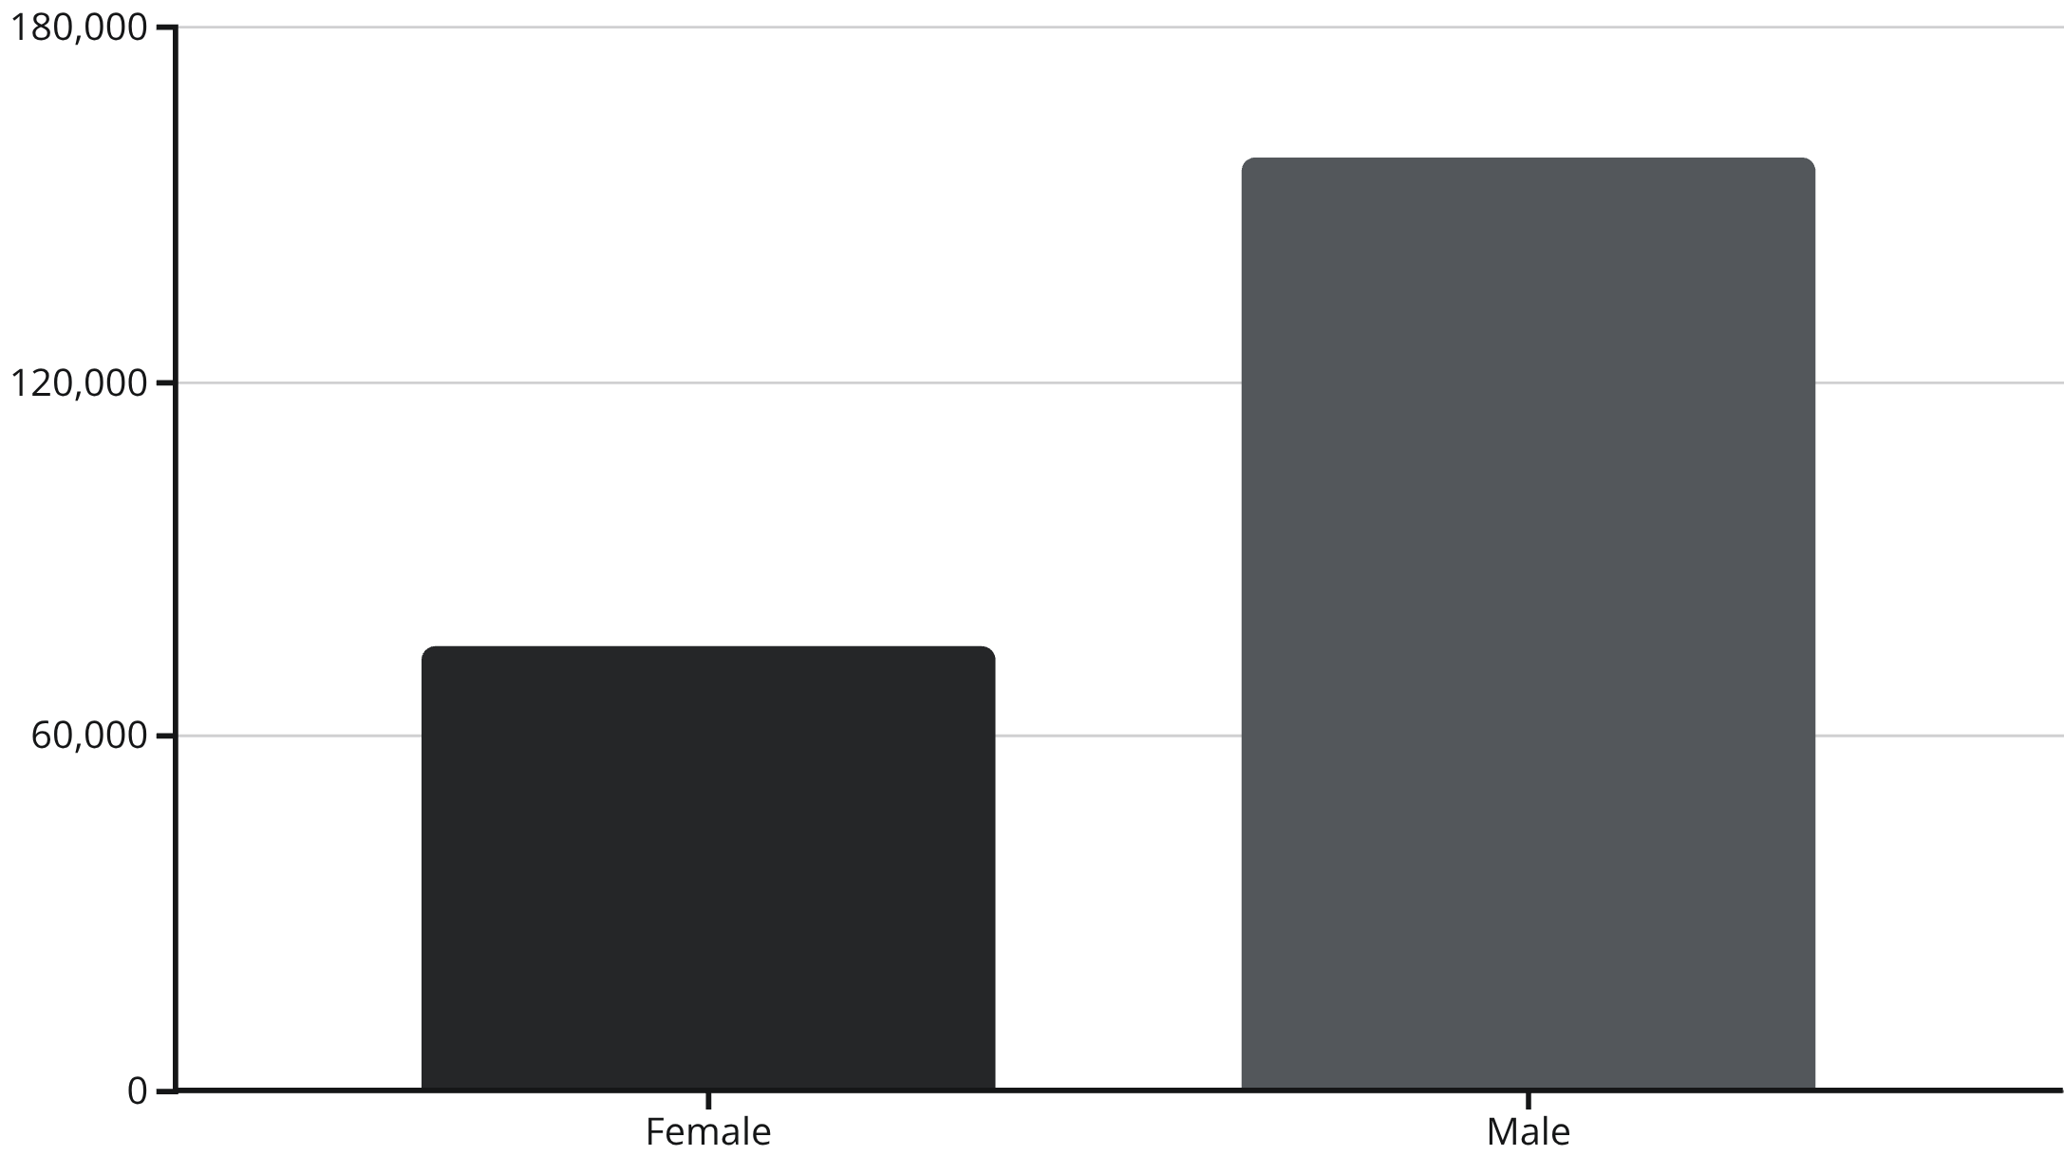
Revenue & Subscription Insights
Subscribers: 1,053 avg spend $59.49 (total $62,645). Non-subscribers: 2,847 avg $59.87 (total $170,436). Subscription penetration: 27% Yes / 73% No.

Slide 6





Top Products & Ratings
Gloves
Sandals
Boots
Hat
Avg rating 3.86 — top-rated among items.
Avg rating 3.84.
Avg rating 3.82.
Avg rating 3.80 — also highest discount rate (50%).
Skirt
Avg rating 3.78.

Slide 7

Discounts & High-Spending Discount Users
Identified 839 rows of discount users who still spent above average. Top discount-dependent items: Hat (50%), Sneakers (49.66%), Coat (49.07%), Sweater (48.17%), Pants (47.37%).
Recommendation: review discount policy to balance volume vs. margin.

Slide 8

Customer Segments & Behavior
Returning 701
Loyal 3,116
New 83
Majority are Loyal customers (3,116). Repeat buyer check: repeat buyers—Yes 958, No 2,518.

Slide 9
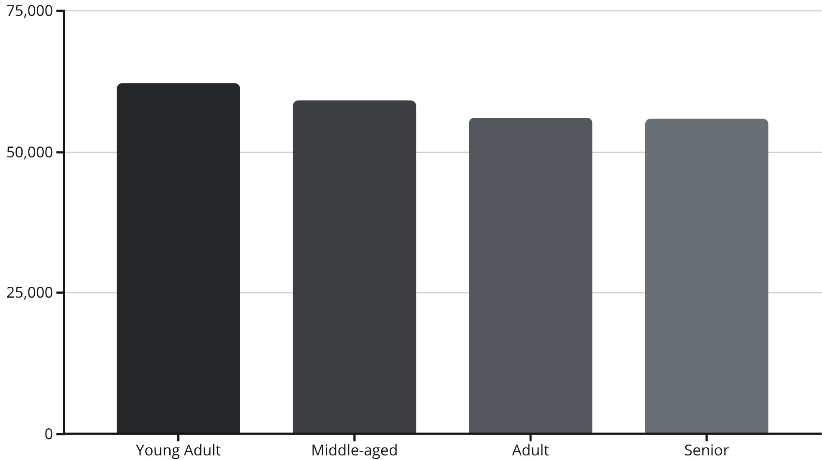

Age & Shipping Patterns
Shipping comparison: Standard avg $58.46 vs. Express avg $60.48. Focus marketing on high-revenue age groups (Young Adult, Middle-aged).

Slide 10
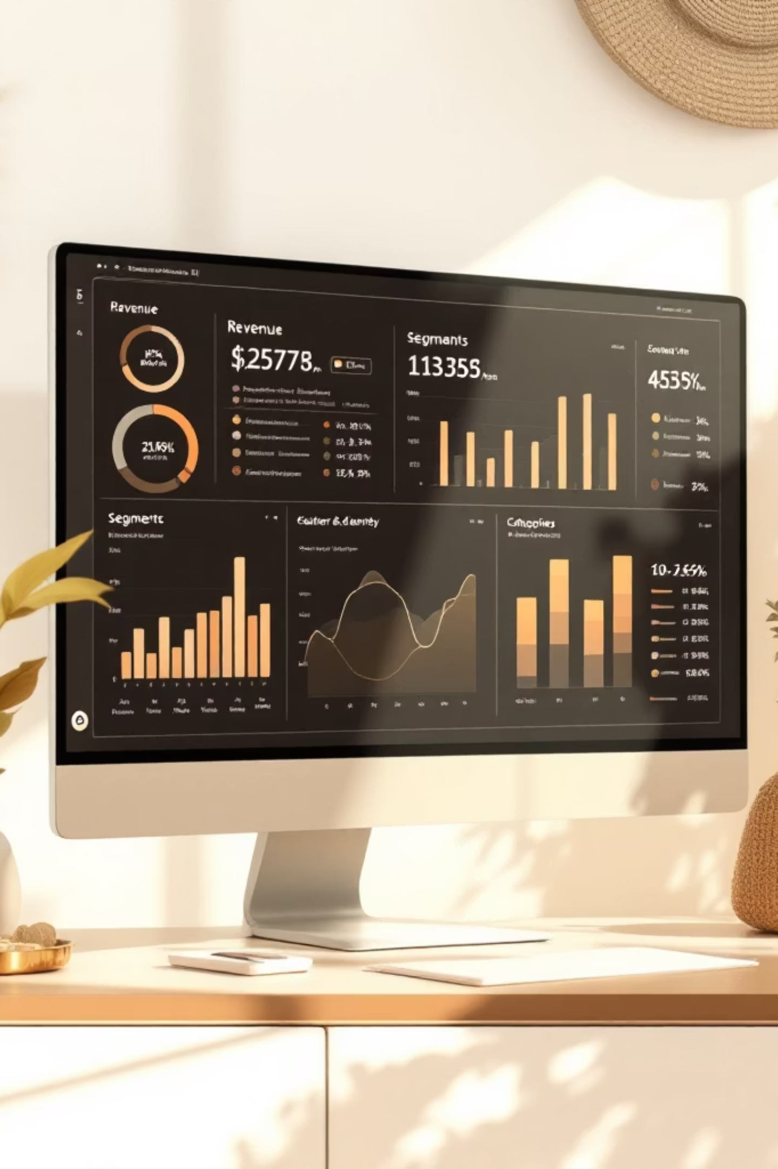
Recommendations & Dashboard
1
Boost Subscriptions
Promote exclusive benefits to increase penetration from 27%.
2
Customer Loyalty Programs
Reward repeat buyers to grow the Loyal segment and retention.
3
Review Discount Policy
Balance sales lift against margin impact on discount-dependent items.
4
Product Positioning & Targeting
Highlight top-rated and top-selling products; target high-revenue age groups and express-shipping users.

